Slide 1
Compton recoil electron detection using GEANT4
Marc Labiche – NPG Daresbury
16/04/2013
Preliminary investigations
with G4.9.5p01
Some discrepancies observed in the e⁻ longitudinal energy deposition for different GEANT4 versions:
Batic et al. IEEE Nucl. Science Symposium amd Med. Imaging Conf. 2012

Slide 2
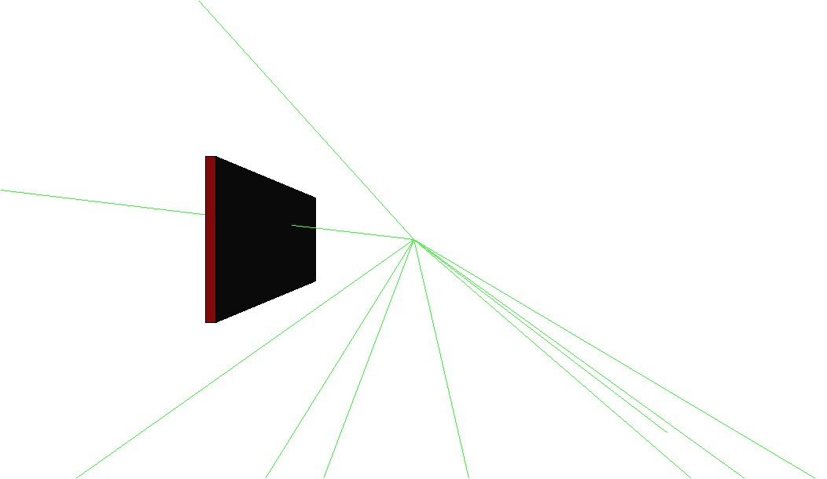
Setup used
Isotropic source at 3cm from Silicon detector
Silicon: ~3cm x ~10cm x 400μm

Slide 3
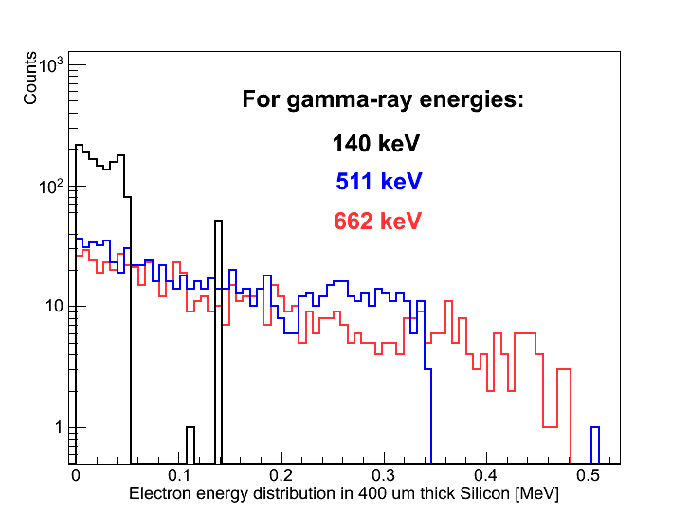
Compton e⁻ deposited energy distribution
Compton edges
No intrinsic energy resolution included
Sharp Compton edges

Slide 4
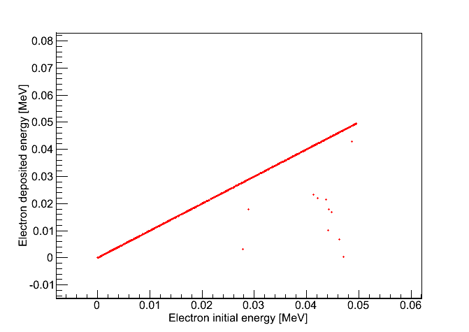
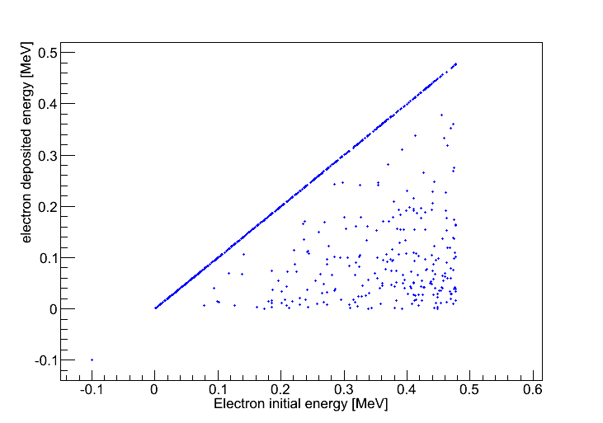
Compton e⁻ deposited energy vs initial kinetic energy
For Eγ=140 keV
For Eγ=662 keV
Compton edge
Compton edge
Deposited energy  initial kinetic energy

Slide 5
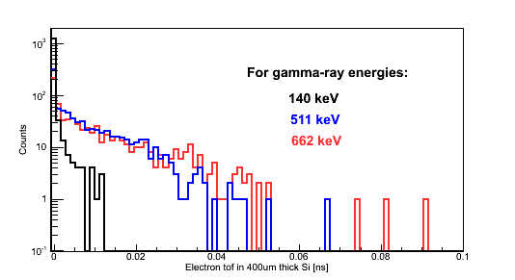
Compton e⁻ tof distribution

Slide 6
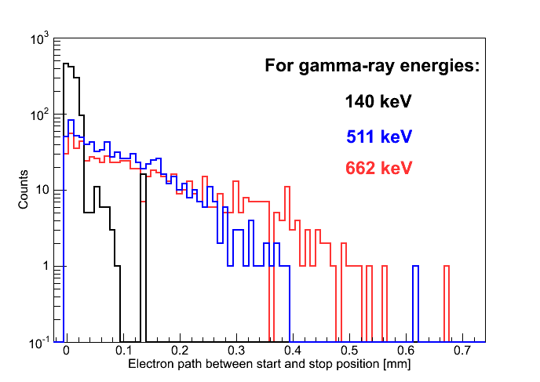
Compton e⁻ path distribution

Slide 7
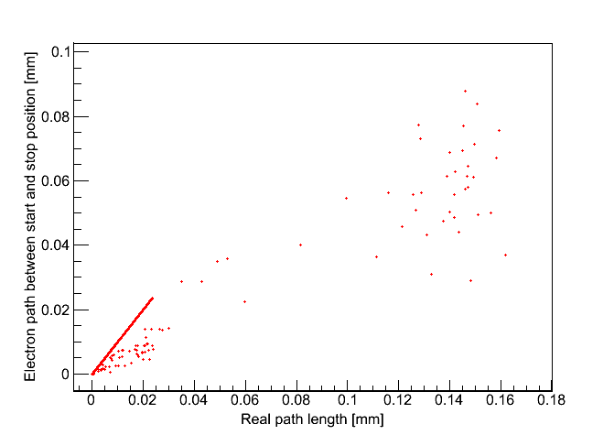
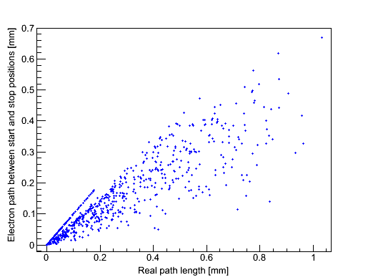
Compton e⁻ start-stop distance vs real path length

Slide 8
Preliminary efficiency curve
Normalized by the number of gamma-ray going through the detector
No threshold in energy

Slide 9
Fin

Slide 10
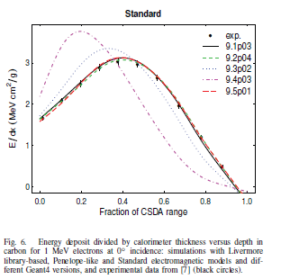
e⁻ longitudinal energy deposition
Batic et al. IEEE Nucl. Science Symposium amd Med. Imaging Conf. Proc. 2012

